Slide 1
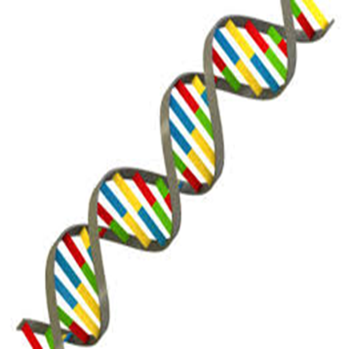
Genetic Algorithm
Litty Tressa George
FICT

Slide 2

Evolution
Evolution is the process of genetic change from one generation to the next generation.
Its a gradual change in the characteristics of a population of animals or plants (any thing) over successive generations
Evolution is defined as the process of growth and development .
It’s the theory that organisms have grown and developed from past organisms.
An example is the theory of evolution stated by Charles Darwin that theorizes about how humans came to be in their present form.

Slide 3
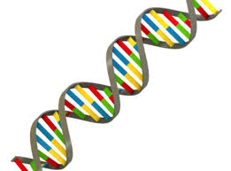
Evolutionary Computing
Branch of artificial intelligence which mimics biological evolution and often applied to optimization problems.
Evolutionary Computing is the study of computational systems which use ideas and get inspirations from natural evolution process and other biological systems.
These types of computing techniques are basically designed for evolution of characteristics inherited from one generation to another generation.
They are computer based problem solving systems which incorporate computational models of evolutionary processes.
EC includes four main methods namely Genetic Algorithms (GA), Evolutionary Strategies (ES), Evolutionary Programming (EP) and Genetic Programming (GP).

Slide 4
Optimization
An act, process, or methodology of making something (such as a method, process, design, system, or decision) as fully perfect, maximum functional, or most effective as possible.
Optimization refers to finding the values of inputs in such a way that we get the “best” output values.
The definition of “best” varies from problem to problem, but in mathematical terms, it refers to maximizing or minimizing one or more objective functions, by varying the input parameters

Slide 5
Genetic Algorithm
Genetic Algorithm (GA) is a search-based optimization technique based on the principles of Genetics and Natural Selection.
It is frequently used to find optimal or near-optimal solutions to difficult problems which otherwise would take a lifetime to solve.
Genetic Algorithms have the ability to deliver a “good-enough” solution “fast-enough”. This makes genetic algorithms attractive for use in solving optimization problems.

Slide 6
Genetic Algorithm
In GAs, we have a pool or a population of possible solutions to the given problem.
These solutions then undergo recombination and mutation (like in natural genetics), producing new children(new solutions), and the process is repeated over various generations.
Each individual (or candidate solution) is assigned a fitness value (based on its objective function value) and the fitter individuals are given a higher chance to reproduce and yield more “fitter” individual solutions .
This is in line with the Darwinian Theory of “Survival of the Fittest”.
In this way we keep “evolving” better individuals or solutions over generations, till we reach a stopping criterion.

Slide 7
Genetics – Biological Terminologies
Genetics is viewed as the study of heredity and the variation of inherited characteristics.
The population consists of a set of chromosomes, each of which,, is made up of genes.
A chromosome is usually taken to represent a complete “individual”within the population—in other words, a complete representation of a solution, or a classification
In GA normally we use Holland’s approach, where a chromosome represents an entire individual.
Each gene in the chromosome represents some facet of that individual’s genetic makeup

Slide 8
GA - Introduction
The simplest representation for genetic algorithms is the one that was used by John Holland: a string of bits.
A string of bits is known as a chromosome, and each bit is known as a gene.
Both of these terms are directly borrowed from genetics and illustrate the close manner in which genetic algorithms mirror biological processes.

Slide 9
Basic Terminologies in G A
Population − It is a set of all the possible (encoded) solutions to the given problem. The population for a GA is analogous to the population for human beings except that instead of human beings, we have Candidate Solutions.
Chromosomes − A chromosome is one such solution to the given problem.
Gene − A gene is one element position of a chromosome.
Allele − It is the value a gene takes for a particular chromosome.

Slide 10
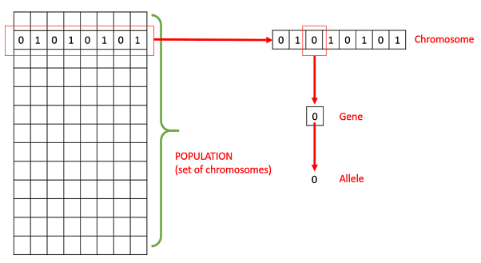
Population , Chromosomes and Gene

Slide 11
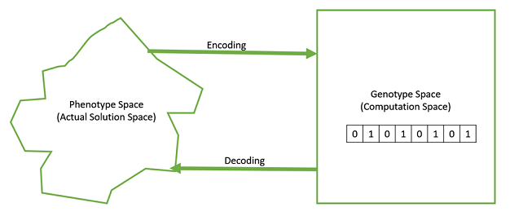

Slide 12
Genotype − Genotype is the population in the computation space. In the computation space, the solutions are represented in a way which can be easily understood and manipulated using a computing system.
Phenotype − Phenotype is the population in the actual real world solution space in which solutions are represented in a way they are represented in real world situations.
Decoding and Encoding − Decoding is a process of transforming a solution from the genotype to the phenotype space, while encoding is a process of transforming from the phenotype to genotype space.

Slide 13
Fitness Function − A fitness function simply defined is a function which takes the multiple solutions as input and produces the most best solutions that satisfies the criteria/ function applied, as the output .
Genetic Operators − These alter the genetic composition of the offspring. These include crossover, mutation, selection etc..

Slide 14
Algorithm Pseudocode
The process for running a genetic algorithm is as follows.
1. Generate a random population of chromosomes (this is the first generation).
2. If the termination criteria are satisfied, stop. Otherwise, continue with step 3.
3. Determine the fitness of each chromosome.
4. Apply crossover and mutation to selected chromosomes from the current generation to generate a new population of chromosomes—the next generation.
5. Return to step 2.

Slide 15
Cross over Operator
The crossover operator is applied to two chromosomes of the same length as follows:
1. Select a random crossover point.
2. Break each chromosome into two parts, splitting at the crossover point.
3. Recombine opposite parts the broken chromosomes by combining the front of one with the back of the other, and vice versa, to produce two new chromosomes.
Note: If a pair of chromosomes does not cross over, then chromosome cloning takes place, and the offspring are created as exact copies of each parent

Slide 16
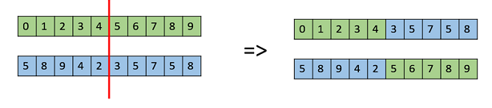
Single Point Crossover
In this one-point crossover, a random crossover point is selected and the tails of its two parents are swapped or interchanged to get new off-springs.

Slide 17
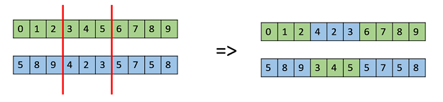
Multipoint Point Crossover
Multi point crossover is a generalization of the one-point crossover where cross over takes places at more than one point or in between points. Here ,alternating segments are swapped to get new off-springs.

Slide 18
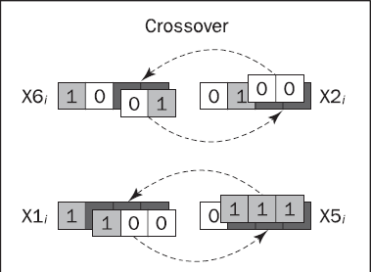
Example

Slide 19
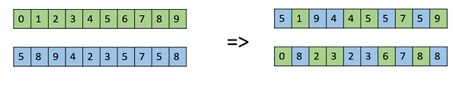
Uniform Crossover
Uniform crossover is also often used to produce just one offspring from each pair of parents, unlike traditional one- or two-point crossover, which usually produces two offspring from each pair of parents.

Slide 20
Mutation
Hill climbing does not perform well with problems where there are local maxima.
To enable genetic algorithms to avoid this problem, the mutation operator was introduced.
Mutation is a unary operator (i.e., it is applied to an individual gene)
The mutation operator flips a selected individual gene in a chromosome.

Slide 21
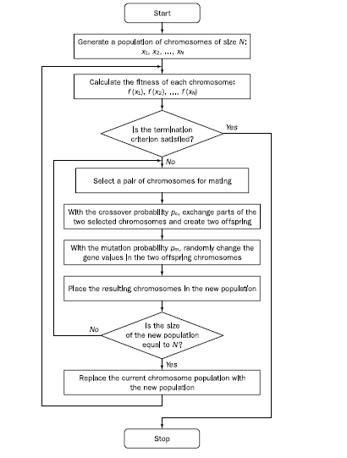
Genetic Algorithm

Slide 22
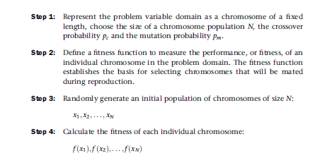
Genetic Algorithm Steps

Slide 23
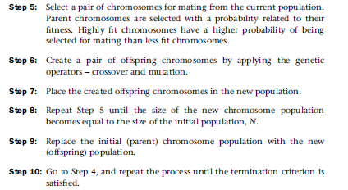
Genetic Algorithm Steps

Slide 24
Genetic Programming

Slide 25
Genetic Programming
Genetic programming is a recent development in the area of evolutionary computation.
It was greatly stimulated in the 1990s by John Koza (Koza, 1992, 1994).
Genetic programming is an extension of the conventional Genetic Algorithm.
Genetic programming offers a solution through the evolution of computer programs by methods of natural selection.
The goal of genetic programming is not just to evolve a bit-string representation of some problem but the computer code that solves the problem.
In other words, genetic programming creates computer programs as the solution, while GAs create a string of binary numbers that represent the solution.

Slide 26
How does Genetic Programming works?
According to Koza, Genetic Programming searches the space of possible computer programs for a program that is highly fit for solving the problem at hand (Koza, 1992).
Any computer program is a sequence of operations (functions) applied to values (arguments),
But different programming languages may include different types of statements and operations, and have different syntactic restrictions.
LISP was chosen as the main language for genetic programming (Koza, 1992).

Slide 27
LISP
LISP, or List Processor, is one of the oldest high-level programming languages.
LISP, which was written by John McCarthy in the late 1950s, has become one of the standard languages for artificial intelligence.
LISP has a highly symbol-oriented structure.
Its basic data structures are atoms and lists.
An atom is the smallest indivisible element of the LISP syntax.
A list is an object composed of atoms and/or other lists.

Slide 28

LISP List- Example
LISP lists are written as an ordered collection of items inside a pair of parentheses.
For example, the list
First, LISP applies the multiplication function (*) to the atoms A and B. Once the list (*AB) is evaluated, LISP applies the subtraction function (-) to the two arguments, and thus evaluates the entire list (-(*AB) C).

Slide 29
LISP - S - Expressions
Both atoms and lists are called symbolic expressions or S-expressions.
In LISP, all data and all programs are S-expressions.
This gives LISP the ability to operate on programs as if they were data.
In other words, LISP programs can modify themselves or even write other LISP programs. This remarkable property of LISP makes it very attractive for genetic programming.

Slide 30
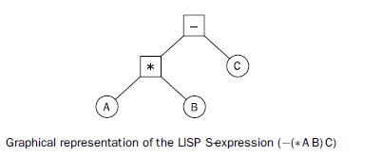
LISP - S - Expressions
Any LISP S-expression can be depicted as a rooted point-labelled tree with ordered branches.
The following figure shows the tree corresponding to the S-expression

Slide 31
LISP - S - Expressions
This tree has five points, each of which represents either a function or a terminal.
The two internal points of the tree are labelled with functions (-) and (*).
Note that the root of the tree is the function appearing just inside the leftmost opening parenthesis of the S-expression.
The three external points of the tree, also called leaves, are labelled with terminals A, B and C.
In the graphical representation, the branches are ordered because the order of the arguments in many functions directly affects the results.

Slide 32
Mandatory Reading page 245 of AI- A guide to intelligent systems, by Michael Negnevitsky.

Slide 33
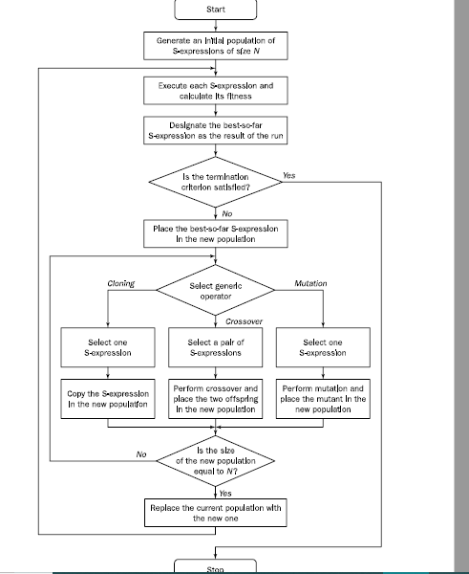
Flow chart of Genetic Programming

Slide 34
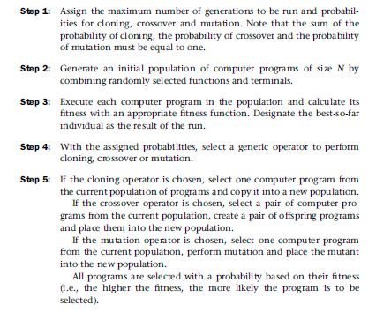
GP Steps

Slide 35




